Slide 1


Slide 2

From Zero to Data Insights Using HDInsight on Microsoft Azure
DBI-B328
Peter Myers
Bitwise Solutions Pty Ltd

Slide 3
Announcement
This presentation was scheduled to be delivered by Brian Mitchell, Lead Architect, Microsoft Big Data COE
Follow him at @brianwmitchell
Contact him at brian.mitchell@microsoft.com

Slide 4



Presenter Introduction
Peter Myers
BI Expert, Bitwise Solutions Pty Ltd
BBus, SQL Server MCSE, MCT, SQL Server MVP (since 2007)
Experienced in designing, developing and maintaining Microsoft database and application solutions, since 1997
Focuses on education and mentoring
Based in Melbourne, Australia
peter.myers@bitwisesolutions.com.au
http://www.linkedin.com/in/peterjsmyers

Slide 5
Session Objectives
To introduce:
Big data
Hadoop
Microsoft Azure HDInsight
To describe big data processes
To demonstrate various big data scenarios
To describe and inspire you with big data capabilities and potential
To provide relevant resources for further investigation

Slide 6
Introducing Big Data
Device Explosion
Social Networks
Cheap Storage
>5.5 billion (70+% of global population)
>2 Billion
users
$100 gets you 3million times more storage in 30 years)
Ubiquitous Connection
Sensor Networks
Inexpensive Computing
Web traffic
2010 130 Exabyte (10 E18)
2015 1.6 ZettaByte (10 E21)
>10 Billion
1980 10 MIPS/$
2005 10M MIPS/$

Slide 7
Introducing Big Data
“Big data is a collection of data sets so large and complex that it becomes awkward to work with using on-hand database management tools. Difficulties include capture, storage, search, sharing, analysis, and visualization.” – Wikipedia

Slide 8



Introducing Big Data Continued
Big data solutions deal with complexities of:
VOLUME
(Size)
VARIETY (Structure)
VELOCITY (Speed)

Slide 9
Introducing Big Data Continued
Internet of things
Social Sentiment
Wikis / Blogs
Exabytes
(10E18)
Sensors / RFID / Devices
Click Stream
Audio / Video
WEB 2.0
Log Files
Mobile
Petabytes
(10E15)
Advertising
eCommerce
Collaboration
Spatial & GPS Coordinates
Volume
ERP / CRM
Digital Marketing
Data Market Feeds
Terabytes
(10E12)
Search Marketing
Payables
Contacts
eGov Feeds
Payroll
Deal Tracking
Web Logs
Weather
Gigabytes
(10E9)
Inventory
Sales Pipeline
Recommendations
Text/Image
Velocity - Variety
ERP / CRM
WEB 2.0
Internet of things
Storage/GB
1980
190,000$
1990
9,000$
2000
15$
2010
0.07$

Slide 10






Introducing Big Data Common Scenarios
Sentiment
Clickstream Analysis
Sensor/Machine
Time and Place
Server Logs
Text

Slide 11
Introducing Big Data Responding to New Questions
Live Data Feed
What’s the social sentiment of my product?
How do I better predict future outcomes?
Social Analytics
Advanced Analytics
How do I optimize my services based on patterns of weather, traffic, etc.?

Slide 12

Introducing Hadoop
Apache Hadoop is for big data
It is a set of open source projects that transform commodity hardware into a service that can:
Store petabytes of data reliably
Allow huge distributed computations
Key attributes:
Open source
Highly scalable
Runs on commodity hardware
Redundant and reliable (no data loss)
Batch processing centric – using “Map-Reduce” processing paradigm

Slide 13
Introducing Hadoop
 | Traditional RDBMS | Hadoop
Data Size | Gigabytes (Terabytes) | Petabytes (Hexabytes)
Access | Interactive and Batch | Batch
Updates | Read / Write many times | Write once, Read many times
Structure | Static Schema | Dynamic Schema
Integrity | High (ACID) | Low
Scaling | Nonlinear | Linear
DBA Ratio | 1:40 | 1:3000
Reference: Tom White’s Hadoop: The Definitive Guide

Slide 14
How it Works
FIRST, STORE THE DATA
Server
Server
Files
Server
Server

Slide 15

How it Works
SECOND, TAKE THE PROCESSING TO THE DATA
RUNTIME
Code
// Map Reduce function in JavaScript
var map = function (key, value, context) {
var words = value.split(/[^a-zA-Z]/);
for (var i = 0; i < words.length; i++) {
if (words[i] !== "")
context.write(words[i].toLowerCase(),
1);}
}};
var reduce = function (key, values, context) {
var sum = 0;
while (values.hasNext()) {
sum += parseInt(values.next());
}
context.write(key, sum);
};
Server
Server
Server
Server

Slide 16
Demonstration
1 – Word Count (The “Hello World” for Hadoop)

Slide 17
Introducing the Hadoop Ecosystem
Pipeline / workflow
(Oozie)
PowerShell
C#, F#, .NET
Graph
(Pegasus)
Stats processing
(RHadoop)
Machine Learning
(Mahout)
Data Integration
( ODBC / SQOOP/ REST)
Relational
(SQL Server)
Legend
Red = Core Hadoop
Blue = Data processing
Purple = Microsoft integration points and value adds
Orange = Data Movement
Green = Packages
Metadata
(HCatalog)
PDW Polybase
NoSQL Database
(HBase)
Scripting
(Pig)
Query
(Hive)
Event Driven Processing
Event Pipeline
(Flume)
Distributed Processing
(MapReduce)
Business Intelligence
(Excel, Power View, SSAS)
Distributed Storage
(HDFS)
Monitoring & Deployment (System Center)
World's Data (Azure Data Marketplace)
Azure Storage Vault (ASV)
Active Directory (Security)

Slide 18
Introducing HDInsight
HDInsight is Microsoft’s 100% Apache compatible Hadoop distribution
Available as a Microsoft Azure service – presently available in developer preview
Empowers organizations with new insights on previously untouched unstructured data, while connecting to the most widely used BI tools on the planet

Slide 19



Introducing HDInsight
100% Apache Hadoop solution in the cloud
Insights through Excel
Deployment agility
Develop in .NET and Java
Built on Hortonworks Data Platform (HDP)
Can be automated with PowerShell and Command Line

Slide 20
Traditional E-Commerce Data Flow
OPERATIONAL DATA
NEW USER REGISTRY
NEW PURCHASE
NEW PRODUCT
Data Warehouse
ETL Some Data
Logs
Excess Data

Slide 21

New E-Commerce Big Data Flow
OPERATIONAL DATA
NEW USER REGISTRY
NEW PURCHASE
NEW PRODUCT
Logs
Data Warehouse
Raw Data
“Store it All”
Cluster
Logs
How much do views for certain products increase when our TV ads run?
Raw Data
“Store it All”
Cluster

Slide 22
Demonstration
2 – Integration Services ETL with HIVE

Slide 23
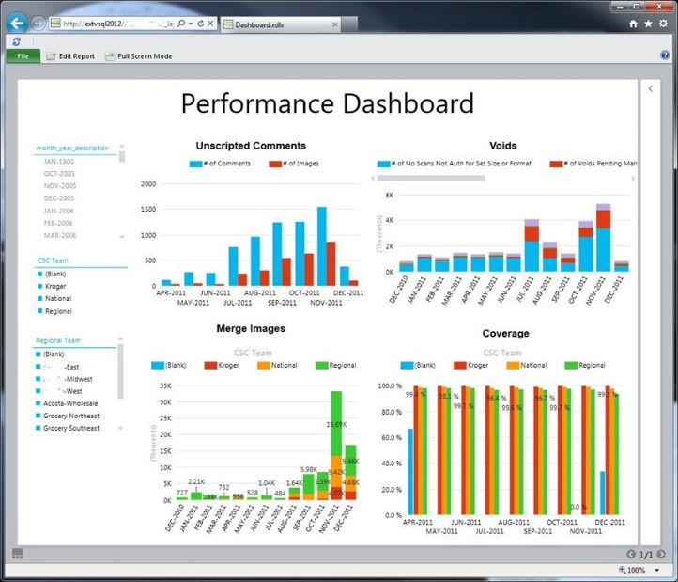
The Hadoop Data Flow
Data
Hadoop
Analytics

Slide 24
Demonstration
3 – Self-Service BI with HIVE

Slide 25
Hadoop Capabilities
Extract Load
Transform
Distributed
Compute
Predictive Analysis
Machine Learning
Graph Processing

Slide 26




Common Big Data Algorithms
Finding Similar Items
Mining Data Streams
Link Analysis
Frequent Item Sets
c
Clustering
Advertising on the Web
Recommendation Systems
Mining Social-Network Graphs

Slide 27

Common Big Data Algorithms Data Mining Streams
Sensor Data
Images Data
Internet and Web Traffic

Slide 28



Common Big Data Algorithms Finding Similar or Complimentary Items
Similar Web Pages
Collaborative Filtering

Slide 29



Common Big Data Algorithms Frequent Item Sets – Market Basket Analysis
Market Basket Analysis
Plagerism
Related Concepts
BioMarkers

Slide 30
Demonstration
4 – Analysis Services Data Mining with HIVE

Slide 31
Summary
Data
Knowledge
Action

Slide 32
Summary Continued
It is likely that you have big data – you’re definitely capturing outcome data, and likely capturing ambient data
All data – outcome or ambient – has value
Today’s challenge is about unleashing insights from any data
Microsoft Azure HDInsight can address these challenges by storing and processing big data
Power BI includes authoring add-ins to query, analyze and visualize data sourced from Windows Azure HDInsight
SQL Server can connect to, query, and consume big data results – big data is just another data source!

Slide 33


Klout is an organization that measures influence online
A Microsoft case study describes how Klout produced a multidimensional BI Semantic Model (cube) based on their open-source Hive data warehouse system

Slide 34
Resources
Microsoft Big Data web site
http://www.microsoft.com/en-us/server-cloud/solutions/big-data.aspx
Microsoft Azure HDInsight web site
http://azure.microsoft.com/en-us/documentation/services/hdinsight/
Hortonworks tutorials
http://hortonworks.com/tutorials
Numerous tutorials are available to learn about big data by using the Hortonworks Sandbox
Klout case study
http://www.microsoft.com/sqlserver/en/us/product-info/case-studies/klout.aspx

Slide 35

Track resources
Download Microsoft SQL Server 2014
http://www.trySQLSever.com
Try out Power BI for Office 365!
http://www.powerbi.com
Sign up for Microsoft HDInsight today!
http://microsoft.com/bigdata

Slide 36

Resources
Learning
Sessions on Demand
Microsoft Certification & Training Resources
http://channel9.msdn.com/Events/TechEd
www.microsoft.com/learning
TechNet
msdn
Resources for IT Professionals
Resources for Developers
http://microsoft.com/technet
http://microsoft.com/msdn

Slide 37



Complete an evaluation and enter to win!

Slide 38


Evaluate this session
Scan this QR code to evaluate this session

Slide 39


© 2014 Microsoft Corporation. All rights reserved. Microsoft, Windows, and other product names are or may be registered trademarks and/or trademarks in the U.S. and/or other countries.
The information herein is for informational purposes only and represents the current view of Microsoft Corporation as of the date of this presentation. Because Microsoft must respond to changing market conditions, it should not be interpreted to be a commitment on the part of Microsoft, and Microsoft cannot guarantee the accuracy of any information provided after the date of this presentation. MICROSOFT MAKES NO WARRANTIES, EXPRESS, IMPLIED OR STATUTORY, AS TO THE INFORMATION IN THIS PRESENTATION.

